Slide 1
GlowAI
SKIN CONDITION CLASSIFICATION
FROM SYNTHETIC DATA
Submitted by: Lin Schneider, Reut Sasson, Ron Noiman | Course: GenAI | Year: 2026

Slide 2


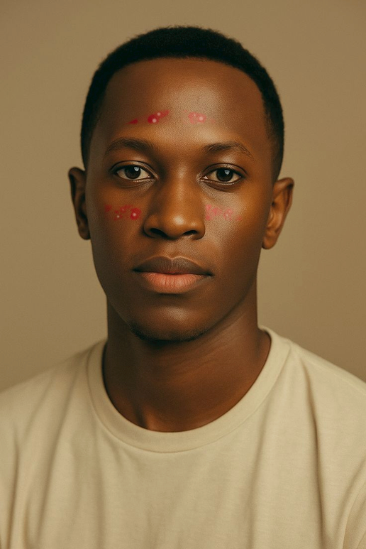


Project Definition
Goal & Motivation
Goal: Classify face images into three classes – acne, erythema, none.
Motivation: Quick pre-screening from consumer-grade images (selfies), not a medical diagnosis.
Input & Output
Input: RGB face image (frontal selfie).
Output: Predicted class + confidence score.
- 72% confidence

Slide 3


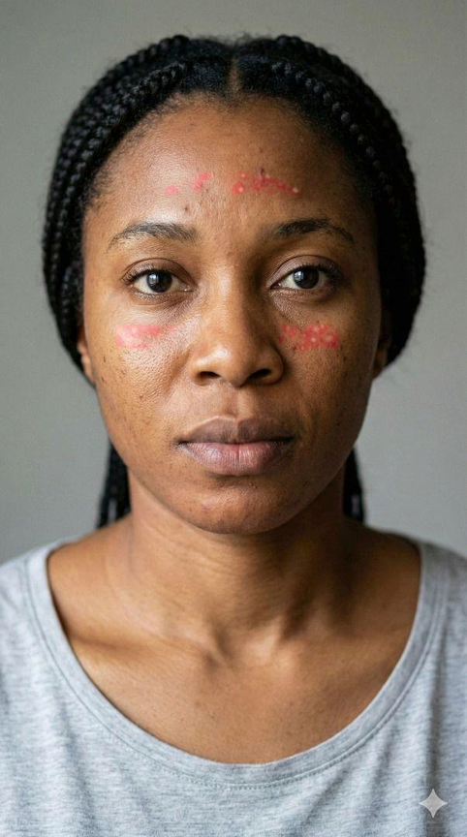
Project Achievements & Novelty
Comparison: Clean vs. Synthetic
Achievements
Trained a 3-class classifier (EfficientNet-B2) combining real and synthetic data.
Built an end-to-end pipeline: generation → training → evaluation → feedback.
Custom Skin Simulator: A Stable Diffusion–based generative framework for realistic simulation of acne and erythema, enabling fine-grained control over lesion location, spatial spread, and severity intensity.
Novelty
Synthetic Data Engine: Solving scarcity of labeled medical data.
Feedback Loop: Manual set to guide improvements.

Slide 4



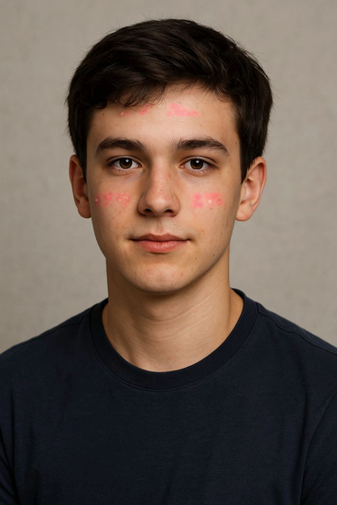
Synthetic Data Generation Using Stable Diffusion
To increase data volume and diversity, we generated synthetic facial images using Stable Diffusion.
Data Generation Process:
Clean facial images were used as base images.
Carefully designed prompts were applied to synthetically add:
Acne (red inflamed pimples with whiteheads)
Facial redness (erythema)
The identity, facial structure, and lighting of the original image were preserved to ensure realism and consistency.
For each generated image, a corresponding pixel-level segmentation mask was created, aligned with the synthetic skin conditions.

Slide 5
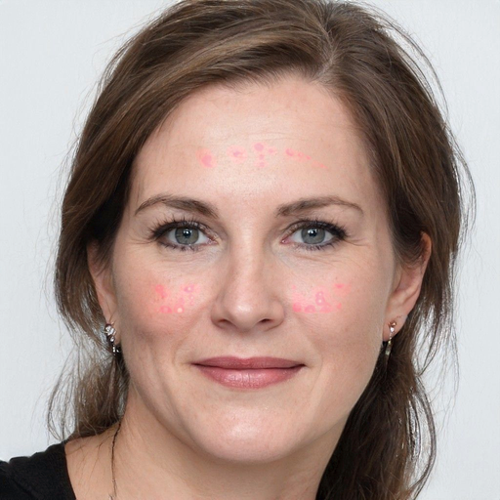

Synthetic Data Generation – Prompt Examples
Prompt Template 1 — Acne Simulation
Generate a realistic version of the same face with mild to moderate acne vulgaris
Add red inflammatory pimples and pustules with visible whiteheads
Target areas: cheeks, forehead, chin
Acne should blend naturally with existing skin texture and lighting
Do not alter facial identity, structure, expression, hair, background, or image quality
Prompt Template 2 — Facial Redness (Erythema)
Generate a second version of the same face with realistic facial redness
Add diffuse erythema with smooth, uneven gradients
Target areas: cheeks, nose, chin
No acne, pimples, or texture changes
Preserve exact identity, pose, lighting, shadows, and background

Slide 6


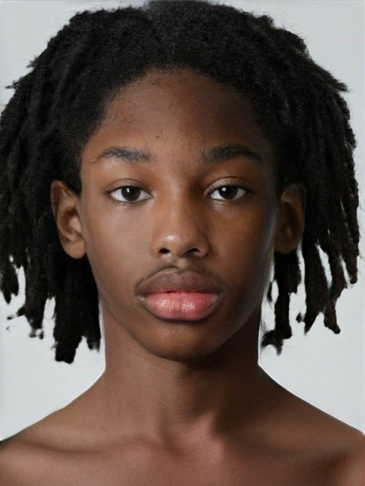
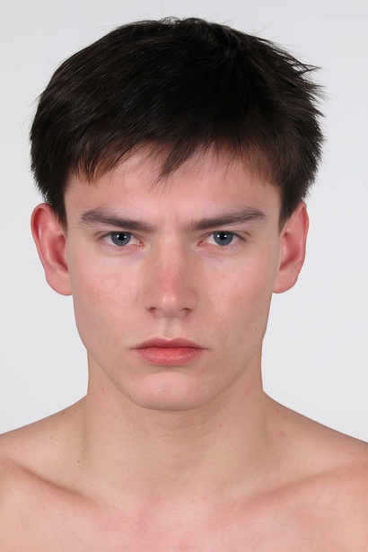
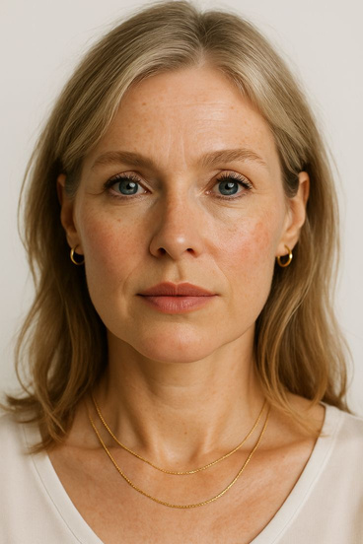

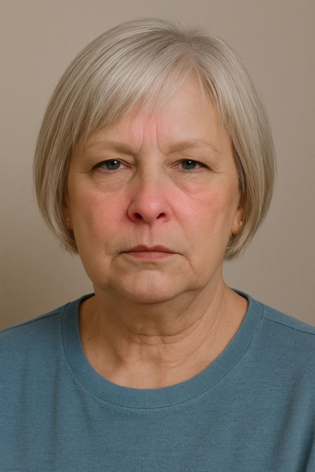
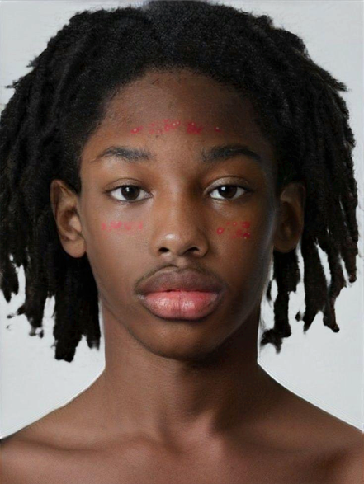



Slide 7
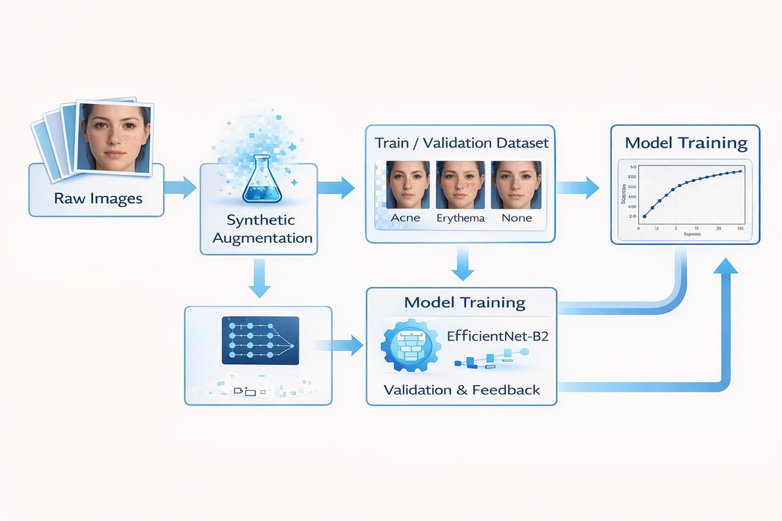
Methodology & Pipeline
Methodology
Data: 3-class dataset (Acne/Erythema/None) mixed with synthetic data.
Preprocessing: Resize 224×224, Normalize (ImageNet).
Augmentations: Flip, rotation, color jitter (mimic selfies).
Training: EfficientNet-B2, Two-stage fine-tuning, AdamW, Cross-Entropy.
Evaluation
Selected best model by validation accuracy.
Analyzed per-class behavior via confusion matrix.

Slide 8
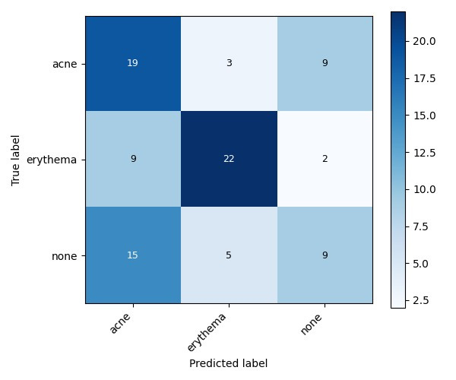
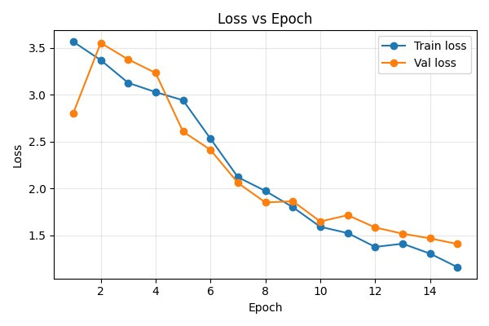
Results: Validation & Manual Test
Validation Results
Manual Test (Real Images)
Best Val Accuracy: ~54%.
Acne: 11/15 | Erythema: 8/9 | None: 17/17
Main issue: "None" often predicted as "Acne/Erythema".
Overall Accuracy: ~88% on curated real-world set.
Significantly better performance on clean input than raw validation metrics suggest.
Confusion Matrix
Training vs Validation Accuracy

Slide 9



Conclusion & Future Work
Conclusion
Limitations
Future Work
Built full synthetic+real classifier pipeline.
Separating mild conditions is difficult.
Expand expert-labeled datasets.
Move to pixel-level segmentation.
Reached ~54% Val / ~88% Real Test accuracy.
Class imbalance impacts robustness.
Use diffusion models for better realism.
Synthetic data is useful but highlights class overlap challenges.
Single-label setup is a simplification of reality.
"These improvements could lead to a more accurate and clinically relevant skin analysis system."

